Slide 1


Time Series Clustering Using US Industries
By Will Davis, Tricia Dudley, Olivia Sylvester,
Department of Mathematical Sciences
Mentored By
Dr. Jim Livsey, U.S. Census Bureau
Dr. Lan Cheng, SUNY Fredonia

Slide 2
Project Goal and Importance
Goal:
Compare industry data ranging from 1992 to 2021 based on different statistical measures
Extracted from United States Census Bureau archives
Attempt to discern potential correlations among multiple industries
Importance:
Businesses are being made with more emphasis on insights from data
Analyze industry datasets through the use of clustering data and time series graphs
Notes:
The data used in this project comes from the United States Census Bureau archives, specifically historical data on US industries. There are 6 different sets of data for over 150 industries, each with a different economic measure. These measurement categories are as follows: Shipments, New Orders, Unfilled Orders, Total Inventories, Inventories to Shipments, and Unfilled Orders to Shipments. Our task is to compare industry data from 1992 to 2021 based upon different statistical measures, and then attempt to discern any potential correlations among multiple industries.

Slide 3
Results
2,136 time series clusters – ½ adjusted and ½ unadjusted data
Many clusters exhibited a similar overall shape, indicating similar economic trends
Clusters with larger means, medians, and standard deviations displayed a strong correlation
Determined that each data set includes multiple industries that were really measures of the same industry
Clustering determined by mean, median, or standard deviation of industry values from 1992-2021

Slide 4
Approach - Data Wrangling
Necessary to analyze and work with the data -
Format data to be easily manipulated in Rstudio
Steps
1. Download excel sheets
2. Create an array that stores each industry code ID code as an element
3. Use the array to filter data specific to each industry
4. Store filtered data with each industry as a column
5. Add final column to include dates for each data entry

Slide 5

Approach - Clustering
Grouping similar sets of data based on similarities of their mean, median, and standard deviation
Use of matrixStats – colMeans, colMedians, and colSds
Steps
1. Insert data into matrixStats to get mean
2. Convert mean data into lists and arrange in ascending order
Separate data into “adjusted” and “unadjusted” classifications
Use written function to plot each column as a time series and then cluster these time series into groups of five
*Cluster the median and standard deviation using the same methodology*

Slide 6
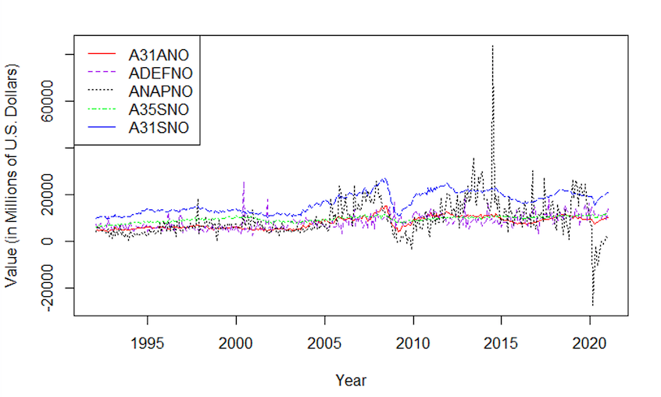
Clustering by Mean
1). Iron and steel Mills and Ferroalloy and Steel Product Manufacturing from Purchased Steel
2). Defense Capital Goods
3). Nondefense Aircraft and Parts
4). Electrical Equipment, Appliances, and Components
5). Primary Metals

Slide 7
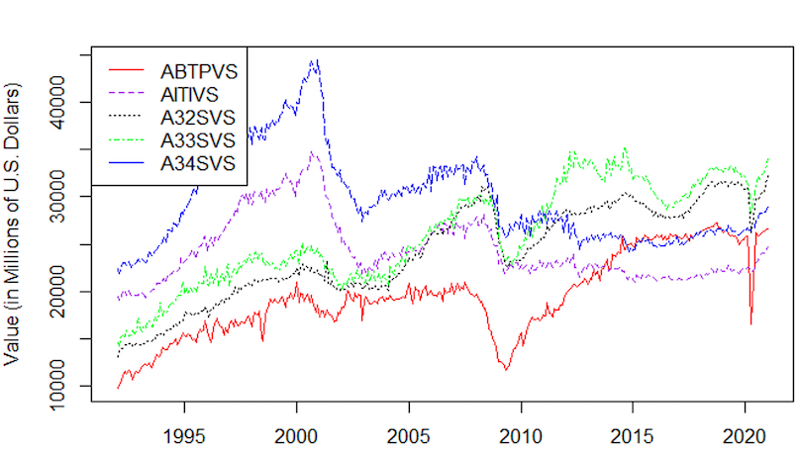
Clustering by Median
1). Motor Vehicle Bodies, Trailers, and Parts
2). Information Technology industries
3). Fabricated Metal Products
4). Machinery
5). Computer and Electronics Products

Slide 8
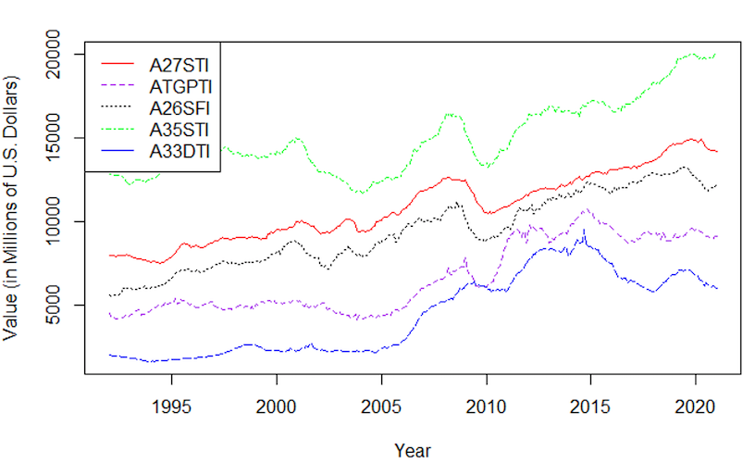
Clustering by Standard Deviation
1). Nonmetallic Mineral Products
2). Turbines, Generators, and Other Power Transmission Equipment
3). Plastic and Rubber Products
4). Electrical Equipment, Appliances, and Components
5). Mining and Oil and Gas Field Machinery Manufacturing

Slide 9
Future Work
To expedite the clustering process, we will create an algorithm to automate the selection of the “best” clusters
Fit a linear regression to each cluster in order to evaluate the models against one another
Determine usefulness of a given model
Calculate and compare R-Squared values for all models
Seek more powerful statistical measurements
Experiment with cluster size

Slide 10
Acknowledgements
“PIC Math is a program of the Mathematical Association of America (MAA) and the Society for Industrial and Applied Mathematics (SIAM). Support is provided by the National Science Foundation (NSF grant DMS-1722275).”
In individual collaboration with Dr. Jim Livsey from the US Census Bureau
Mentored by Dr. Lan Cheng (SUNY Fredonia)
Disclaimer: This report is released to inform interested parties of research and to encourage discussion. The views expressed on statistical issues are those of the authors and not those of the US Census Bureau

Slide 11
References
“US Census Bureau: Adriana Stoica (M3 Section Chief). (2009, September 30). US Census Bureau Manufacturer’ shipments, inventories, and orders main page. United States Census Bureau. Retrieved March 29, 2022, from https://www.census.gov/manufacturing/m3/historical_data/index.html”
“Data Wrangling: What it is & why it’s important. Business Insights Blog. (2021, January 19). Retrieved March 29, 2022, from https://onlinehbs.edu/blog/post/data-wrangling”
“What is clustering? NVIDIA Data Science Glossary. (n.d.). Retrieved March 31, 2022, from https://www.nvidia.com/en-us/glossary/data-science/clustering/”

